Slide 1

C Programming workshop
Presented by Dylan Armstrong – President of Swinburne Linux, Hardware and Code Club (SLHCC)

Slide 2
Contents
Some Initial Theory
A Brief History of C
C Syntax
C Memory Management
Setting up a compiler
Workshop 1 (A Dynamic List Data Structure in C)
Workshop 2 (A Linked List Data Structure in C)

Slide 3
WHAT IS C?
C is a procedural programming language released in 1972 by Dennis Ritchie at Bell Labs.
C is what the Windows, macOS and Linux kernels are written in.
C doesn't have garbage collection, and memory must be managed yourself.

Slide 4
C SYntax
C programs always start with a main function that is of type int. This means, the function should always return an integer code to the operating system such as 0 for successful termination of the program.
Variables are statically typed e.g., can be of type int, char, float, etc.
There are no strings in C! They are character arrays (an array of type char)
#include is a pre-processor directive allowing you to include header files (*.h files) which usually contain libraries and specifications.

Slide 5
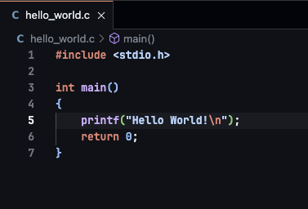

C SYNTAX (CONTINUED…)
Header files should include specification, C files should include implementation.
Variables can be marked constant in c using const.
A hello world program (import the stdio.h library for standard I/O):

Slide 6
C MEMORY MANAGEMENT
Pointers point to a memory address on the heap.
Pointers themselves are declared on the stack.
The functions malloc and calloc can allocate memory on the heap for a pointer variable to point to.
Always free pointers from memory when not being used anymore, otherwise you will have memory leaks in your program.
Only use heap memory in certain situations as it is expensive!
An array or structure that’s size is not known at runtime that can change in size.
… TODO

Slide 7
THE BEST WAY TO LEARN IS BY DOING.

Slide 8
SETTING UP a compiler / Running your program
We use the gcc compiler. (You can use whatever one you prefer, but for new people to C, follow what we are doing).

Slide 9
Workshop 1 – dynamic list data structure
Should contain a dynamic sized array of strings.
Should have 10 as the default size, and once the number of items is equal to 10, increase it by 10 and relocate the memory on the heap to the new size.
Should contain a couple of methods to get the first item and the last item in the list.
Should contain a Makefile for easy compilation (more about this later).

Slide 10
LET’s build A DYNAMIC ARRAY!

Slide 11
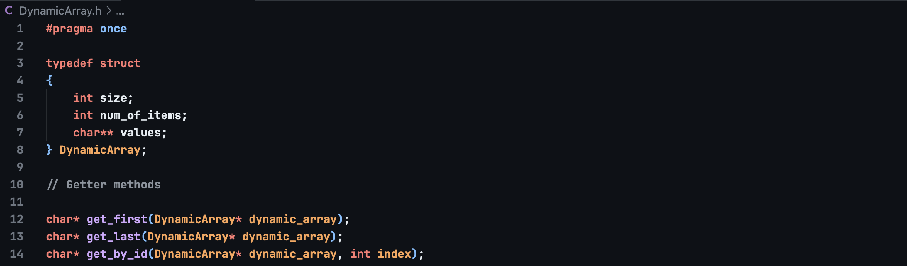
STEP 1 – Dynamicarray.h

Slide 12
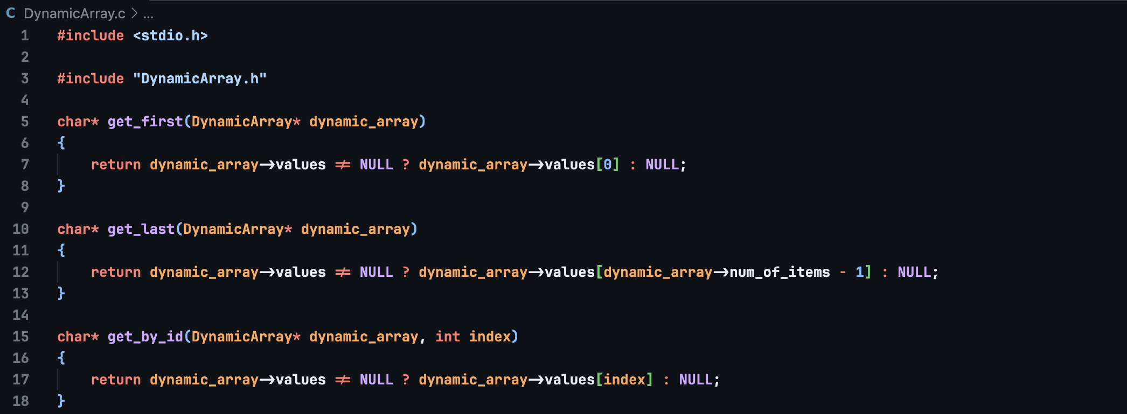
STEP 2 – DYNAMICARRAY.C

Slide 13
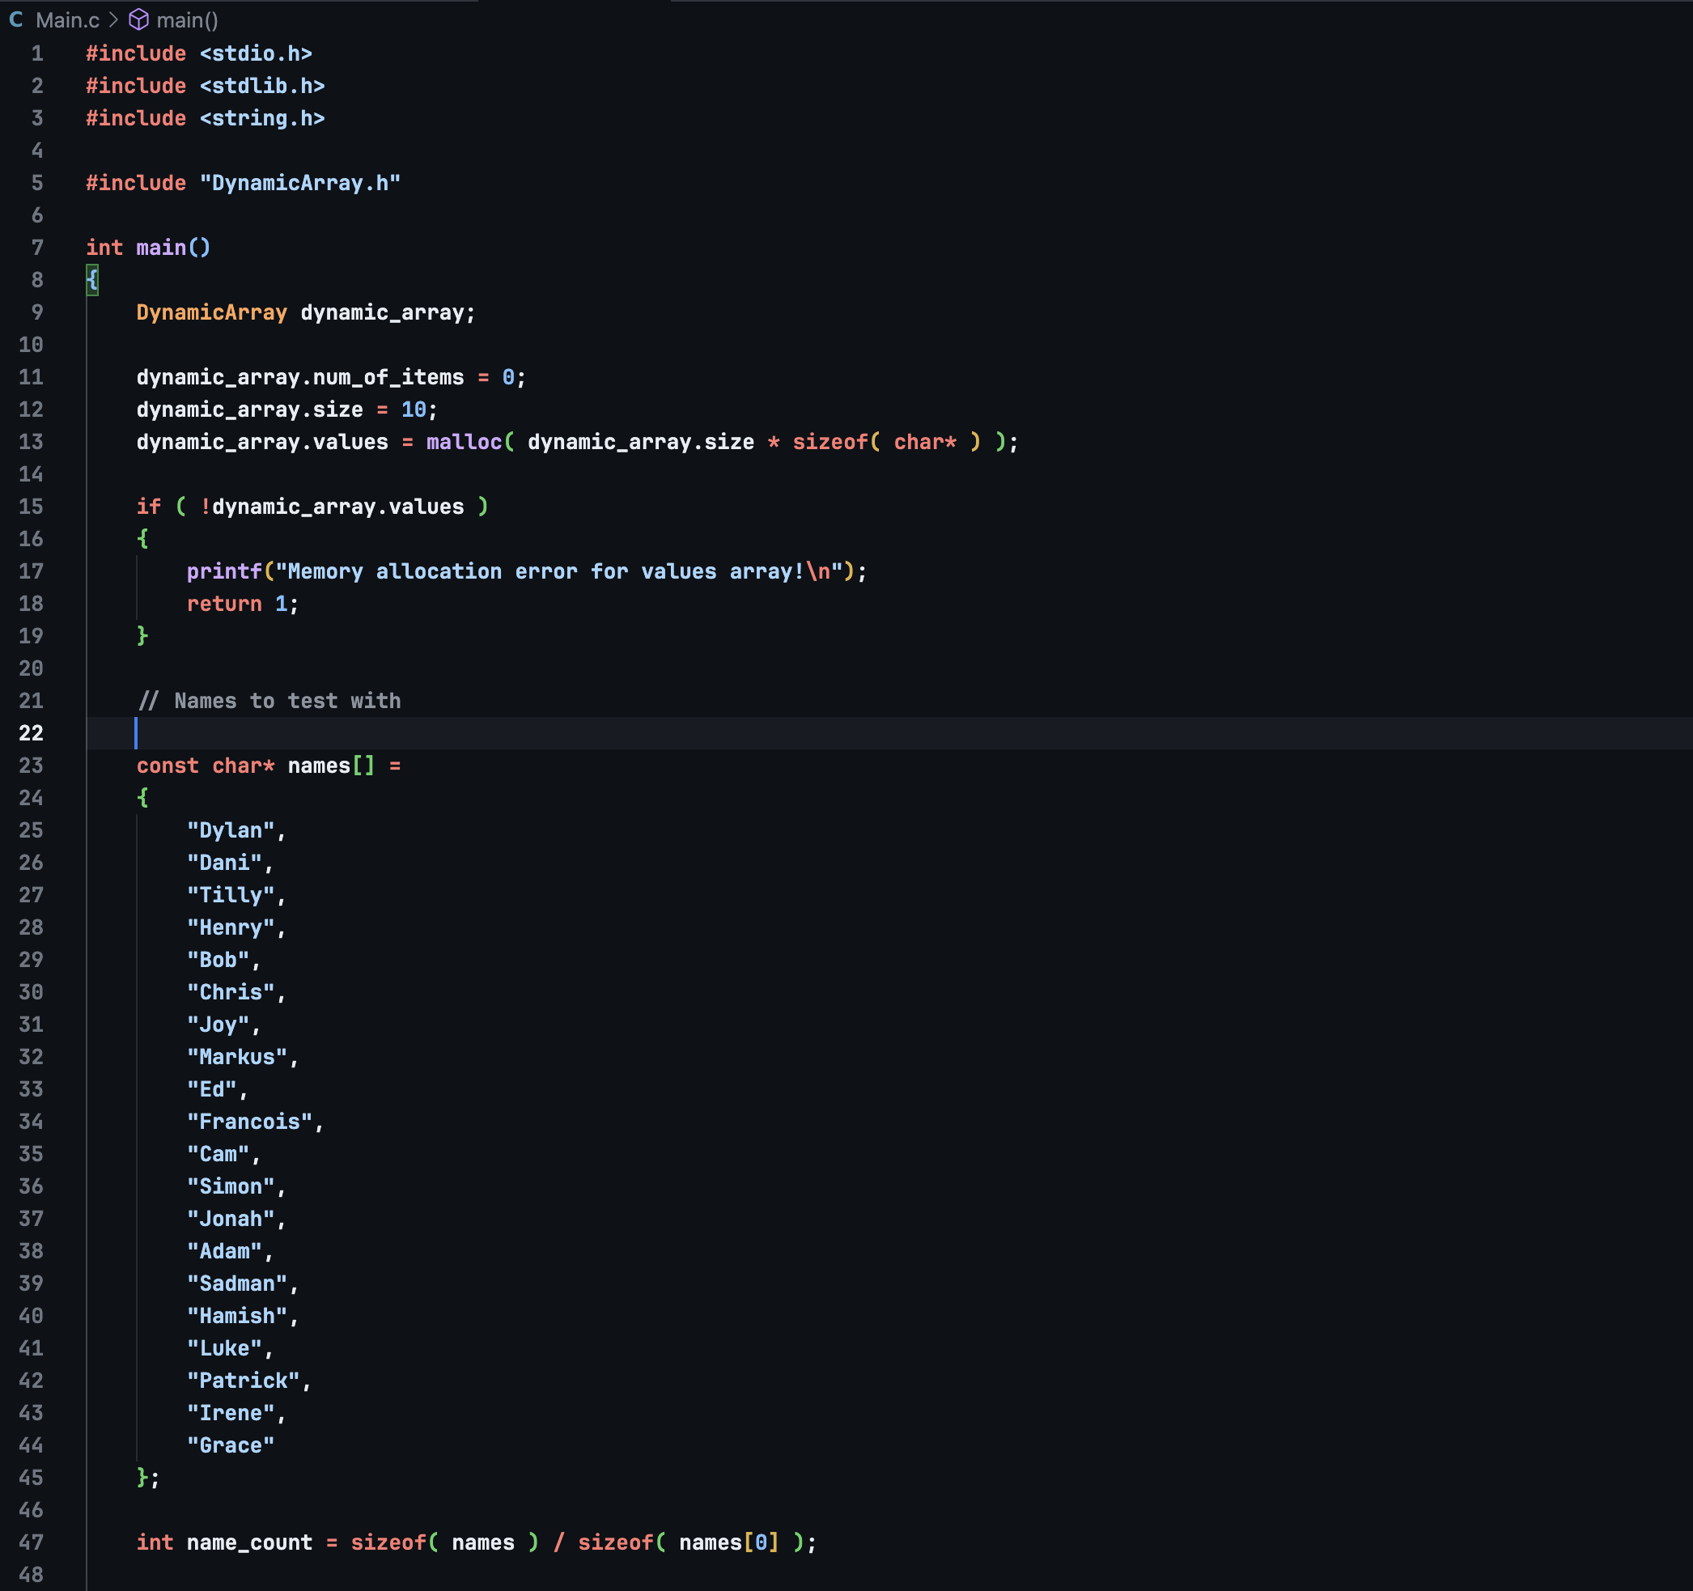
STEP 3 – MAIN.C (PART 1)

Slide 14
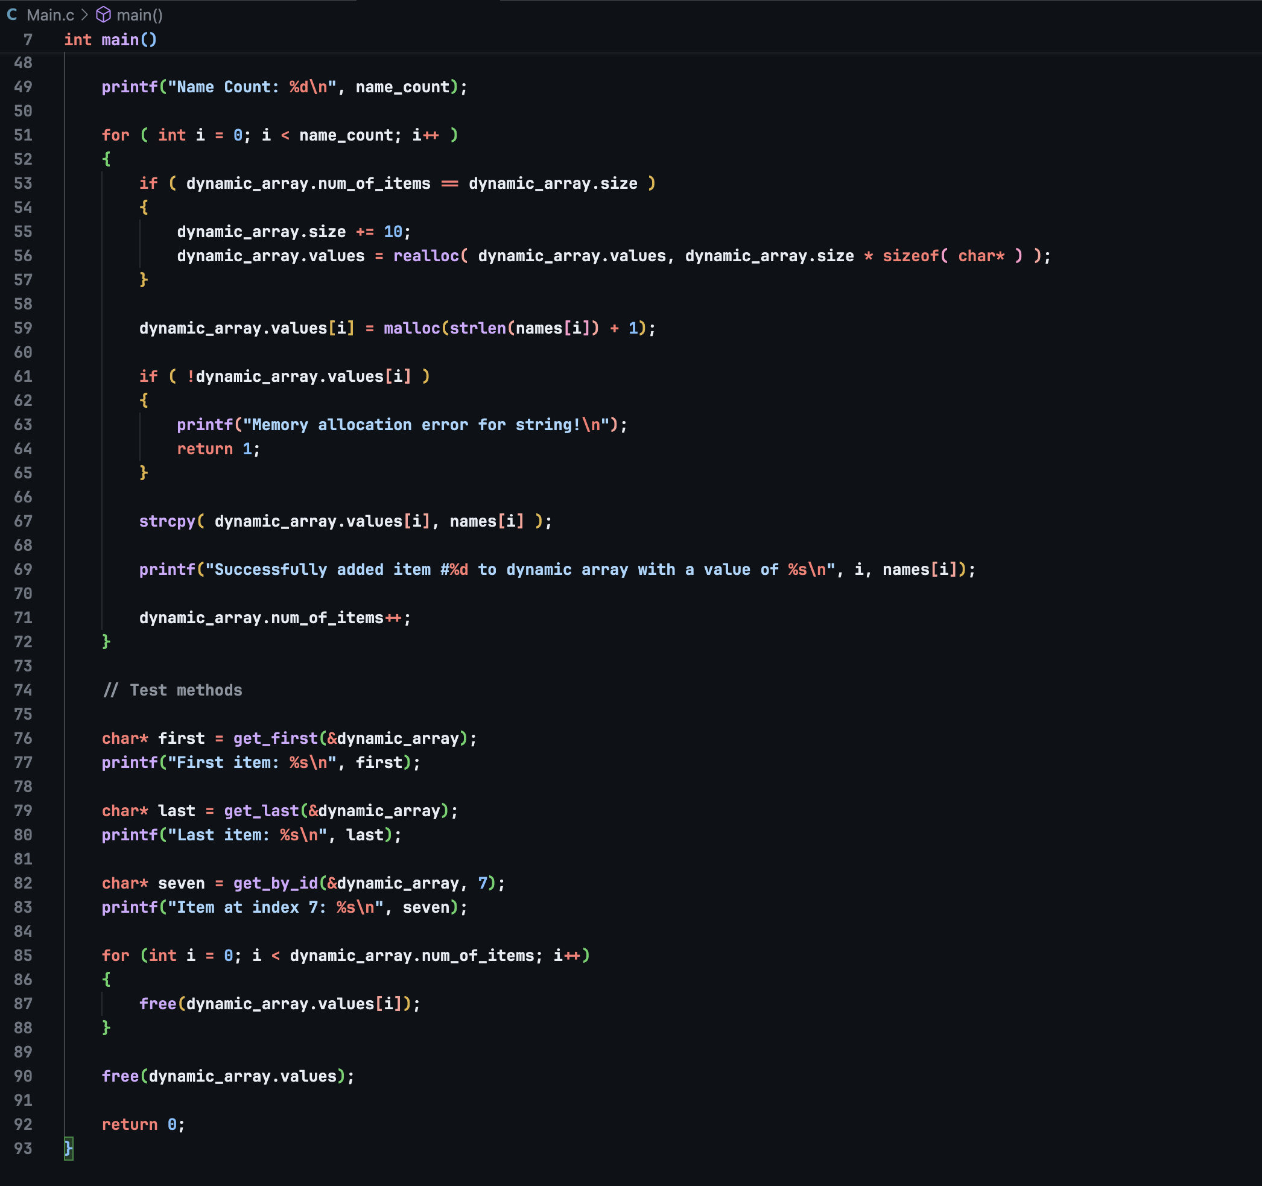
STEP 3 – MAIN.C (PART 2)

Slide 15
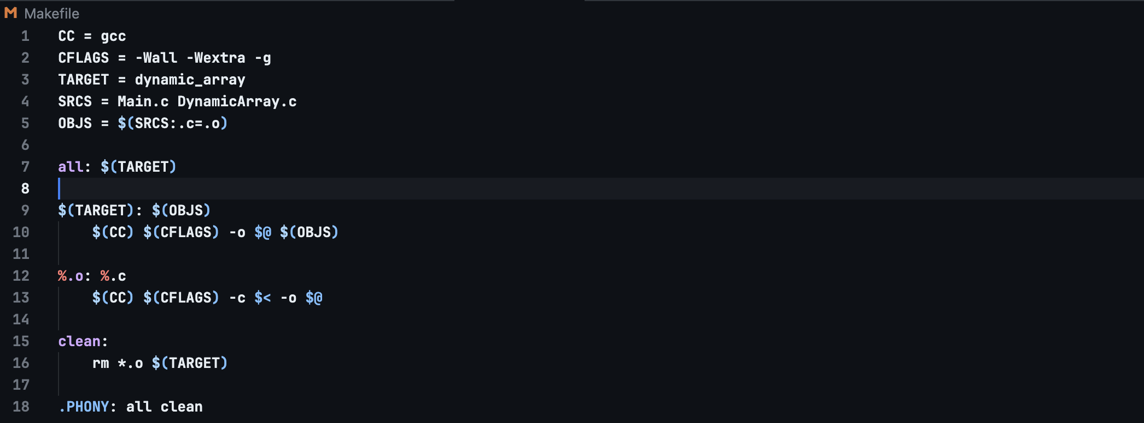
STEP 4 – MAKEFILE (UNIX - MACOS/LINUX)

Slide 16
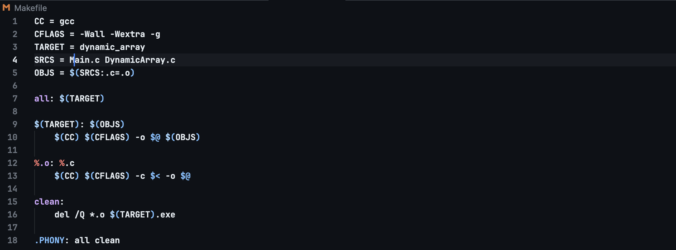
STEP 4 – makefile (WINDOWS)

Slide 17
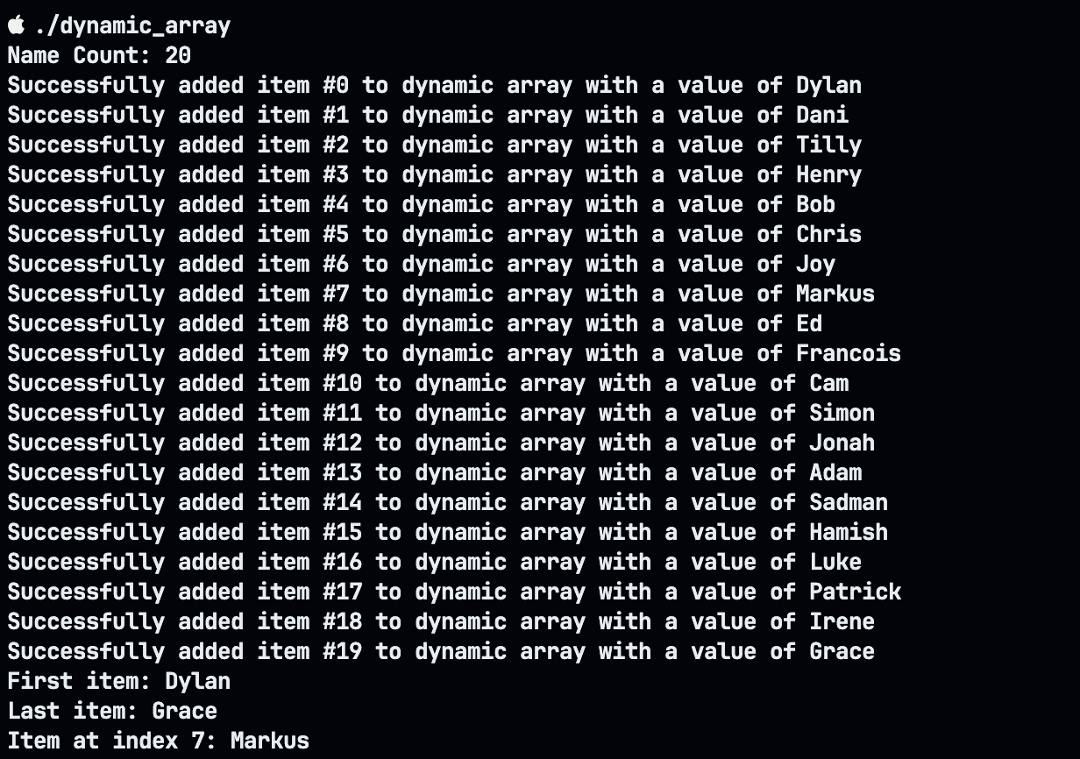
Step 5 – running the program

Slide 18
Workshop 2 – (DOUBLY/BIDIRECTIONAL) linked list data structure
Should contain Nodes that each have a previous and next node.
Each node should contain an integer value.
Should contain methods to print forward and backwards through the linked list.
Should also contain methods to add nodes and free the list from memory.

Slide 19
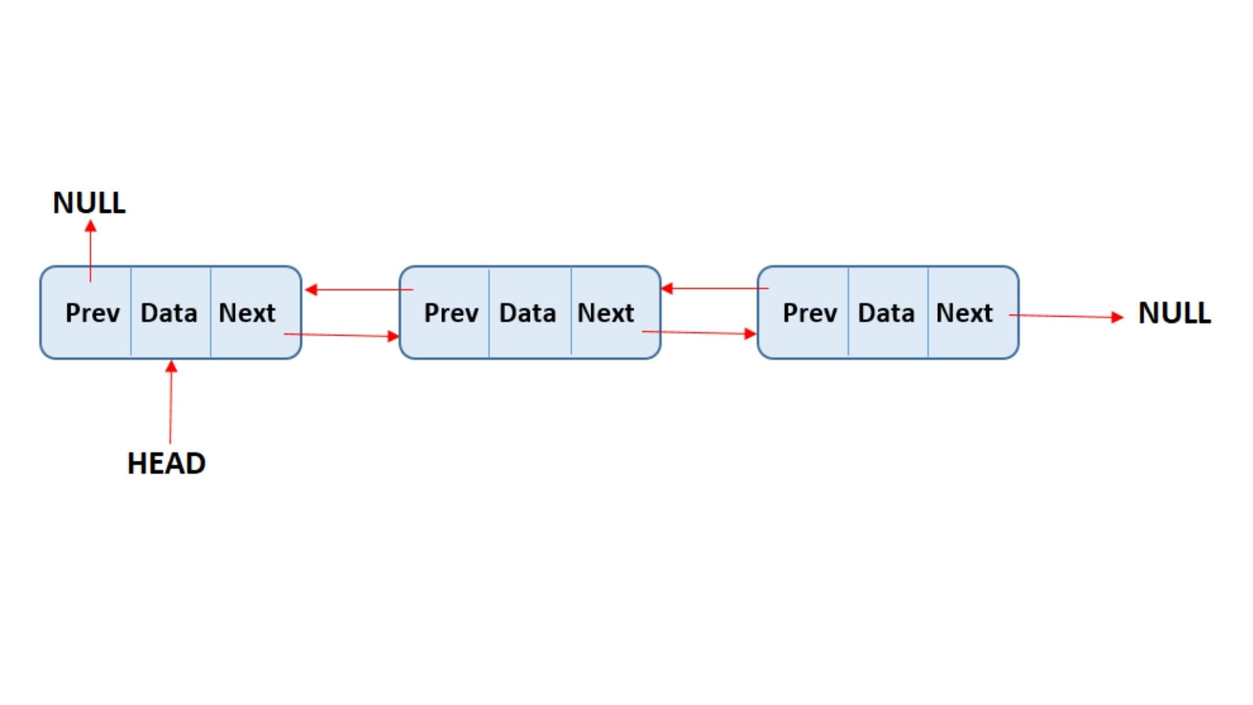
WHAT IS A DOUBLY LINKED LIST?
Source: https://data-flair.training/blogs/doubly-linked-list-in-data-structure/

Slide 20
LET’s build a doubly linked list!

Slide 21
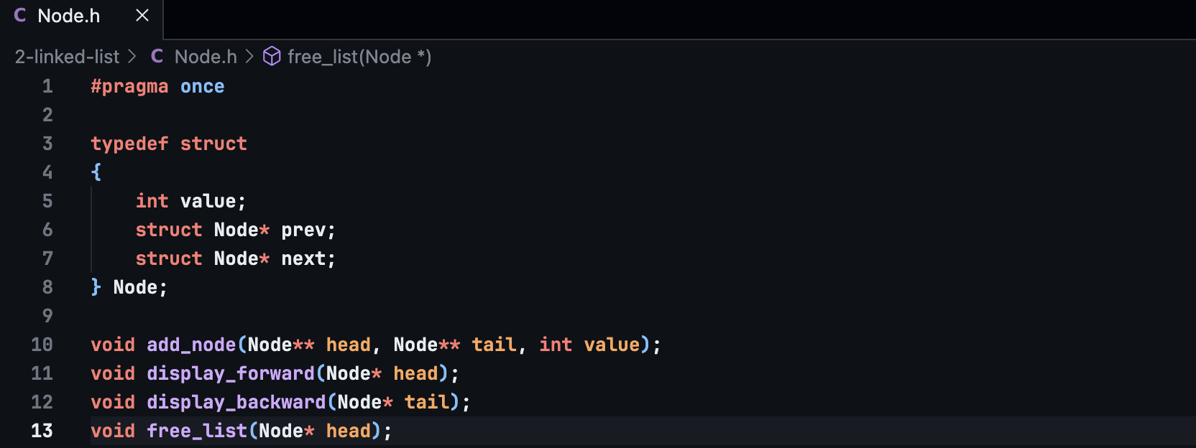
STEP 1 – node.h

Slide 22
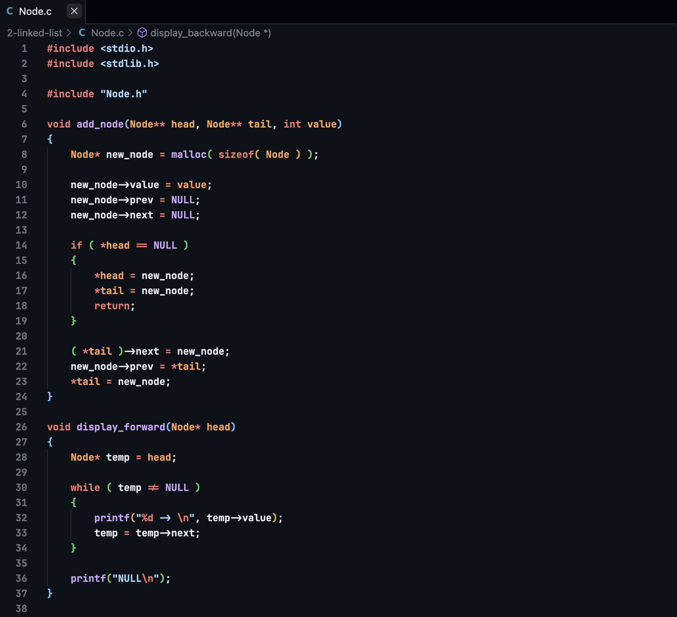
STEP 2 – node.c (PART 1)

Slide 23
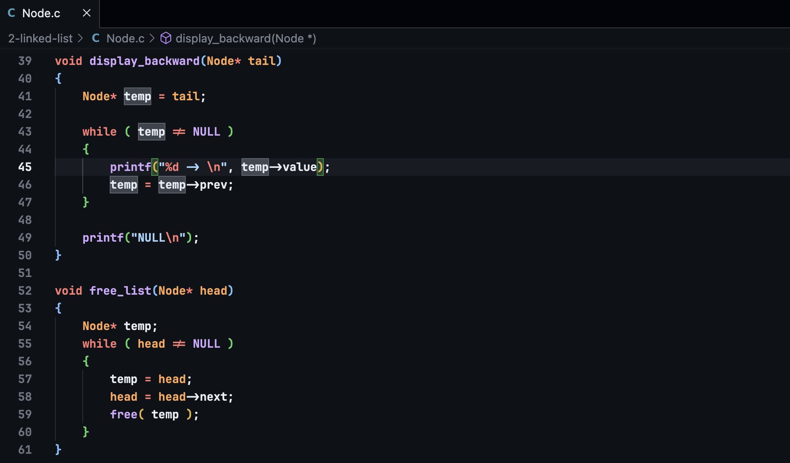
STEP 2 – NODE.C (PART 2)

Slide 24
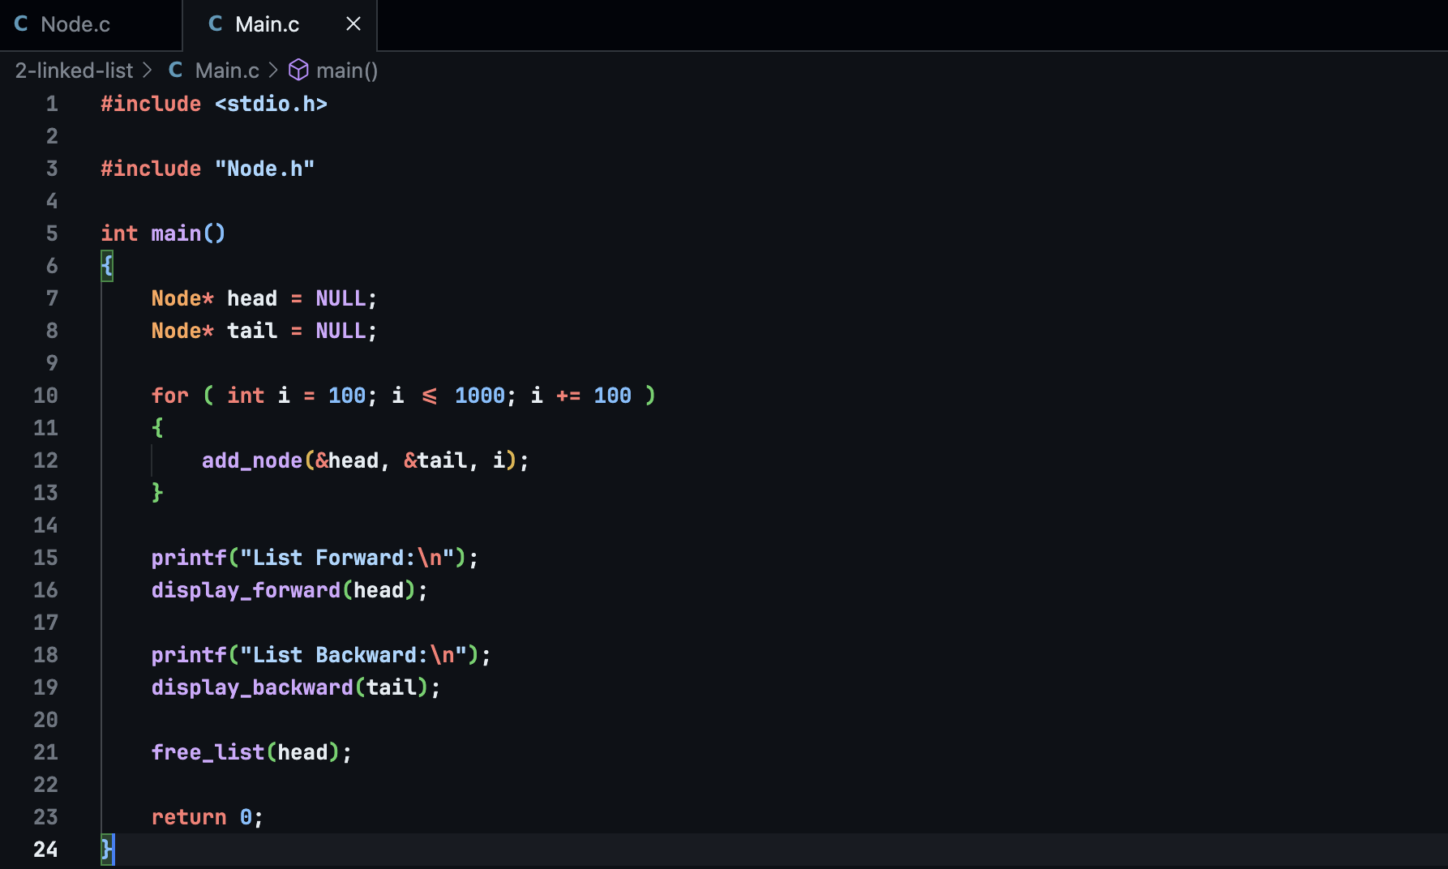
STEP 3 – MAIN.C

Slide 25
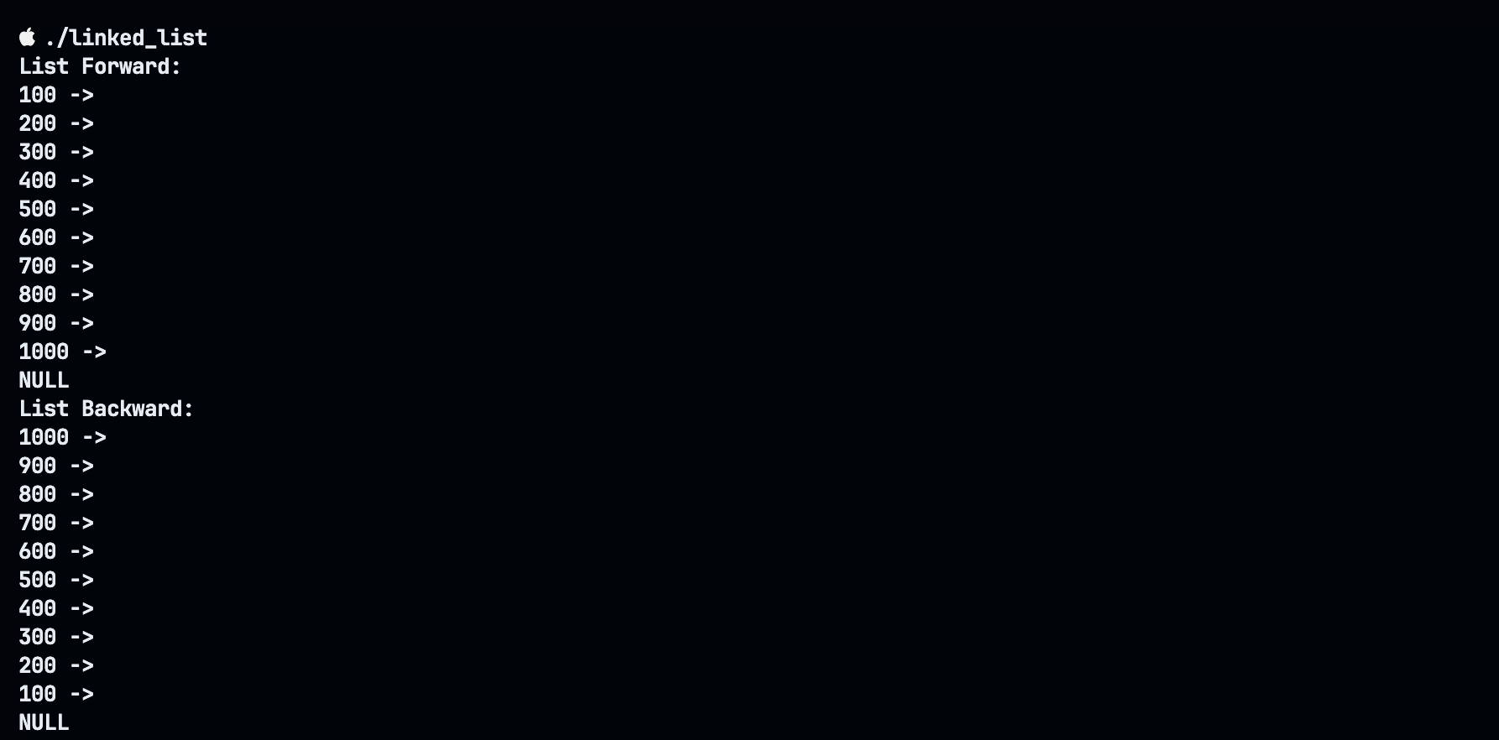
STEP 4 – RUNNING THE PROGRAM

